Slide 1
Lecture 10: TLS and HTTPS
CS 484 Fall 2022
Joshua Reynolds

Slide 2
Cryptography - Secret Writing

Slide 3
Cryptography
Goal -- A and B can communicate with:
Confidentiality
Integrity
Authentication (or sometimes anonymity)
Non-repudiation (or sometimes deniability)

Slide 4
Alice, Bob, Eve, and Mallory

Slide 5
Breaking Caesar’s Cipher Activity
vu xdknc untl tn bcn bmxfd dx bddbqp dkn
zbfrl dxjxccxt buw vd'l zxuub mn b dxdbr
lfcicvln. dkbupl sxc kbovuz lfqk b lbsn
qviknc sxc fl dx fln. vd'l uvqn dx puxt
xurh dkxln xs fl "vu dkn puxt" qbu cnbw
dknln jnllbznl.
hxfc rxhbr lncobud,
lnubdxc srboxcvxfl, sxctbcw qxjjbuwnc
wnbc gfrvfl qbnlbc, svcld qvdvenu, ndq.
dkn kbirnll jnllnuznc v bj lnuwvuz dkvl
rnddnc tvdk kbl cnqnudrh mnnu wvlqxoncnw
mh xfc qxfudncvudnrrvznuqn bznuqh dx mn
b lih sxc dkn zbfrl. v dkxfzkd vd jvzkd
zvon hxf b mvd xs b rbfzk vs kn mcxfzkd
dkvl jnllbzn dx hxf kvjlnrs. irnbln lnn
dx vd dkbd kn vl icxincrh dcvnw buw
ifuvlknw.

Slide 6
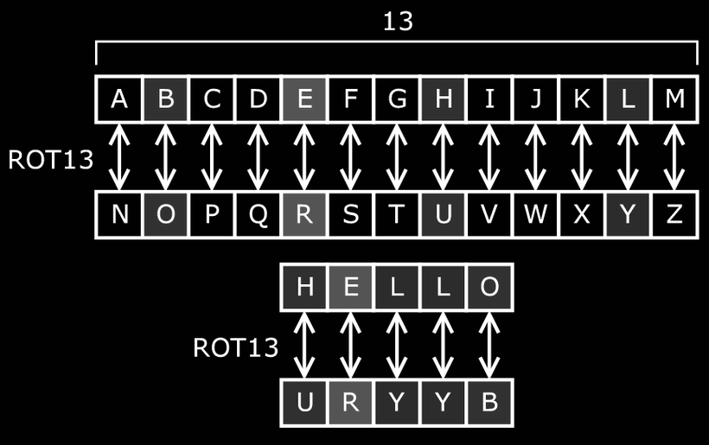
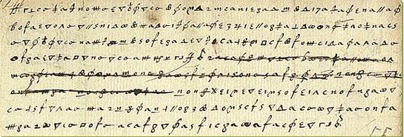
Substitution Cipher
“I w be glad to know the names and quelityes of the sixe gentlemen which are to accomplish the dessignement, for that it may be I shall be able uppon knowledge of the parties to give you some further advise necessarye to be followed therein…… as also from time to time particularlye how you proceede and as son as you may for the same purpose who bee alredye and how farr every one privye hereunto.”
https://www.nationalarchives.gov.uk/spies/ciphers/mary/ma2.htm
Notes:
In 1586 there was an alleged conspiracy to assasinate Elizabeth I of England. As part of the counterespionage effort, Thomas Phelippes, a linguist and cryptographer, added this postscript to a ciphered letter from imprisoned Mary, Queen of Scotts. It asks one of her conspirators to please reply with a list of all people who are connected with the conspiracy.

Slide 7
Hash Functions
Map arbitrarily long input strings to a fixed-length output
Not all hash functions are cryptographically useful!
A cryptographic hash should be:
Preimage Resistant (One-Way): Given H(a) it’s hard to find a
Collision Resistant: It’s hard to find a,b: H(a) == H(b)
Second Preimage Resistant: Given a, it’s hard to find b: H(a) == H(b)
Built with the Avalanche Effect

Slide 8
Ideal Functionality for Symmetric Encryption

Slide 9
One-Time Pads
https://www.khanacademy.org/computing/computer-science/cryptography/crypt/v/one-time-pad

Slide 10

Block Ciphers
Larry Ewing and User:Lunkwill
We imagine the following game:
The person running the game flips a coin.
If the coin lands on heads, he chooses a random key K and defines the function f = EK.
If the coin lands on tails, he chooses a random permutation π on the set of n-bit strings, and defines the function f = π.
The attacker chooses an n-bit string X, and the person running the game tells him the value of f(X).
Step 2 is repeated a total of q times. (Each of these q interactions is a query.)
The attacker guesses how the coin landed. He wins if his guess is correct.

Slide 11
AES: Advanced Encryption Standard
Symmetric encryption and decryption
Message encryptors and decryptors both know the shared key
Works on fixed sized blocks, one at a time
Many block chaining modes (we’ll use CBC for checkpoint 1)
128 bit block size, 3 key sizes (might as well use 256 bits)

Slide 12

Cipher Block Chaining Mode

Slide 13
Asymmetric Cryptography (Public and Private Keys)

Slide 14
Safe Key Length
Symmetric Encryption - Use AES 256
Hash functions: Use SHA-256 or SHA3
Asymmetric RSA - Use 2048 bits or more, 112 bits for Elliptic Curves

Slide 15
Transport Layer Security (TLS) Protocol 1.2 and older
Client
Server
Client Hello
Server Hello
Server Certificate
ServerHelloDone
Client Key
ChangeCipherSpec
Finished
ChangeCipherSpec
Finished

Slide 16
TLS 1.3+ Protocol
Client
Server
Client Hello
Server Hello
Server Certificate
Finished
Finished

Slide 17
Certificates Examination
certmgr
examine certificate

Slide 18
Certificate Authorities

